Slide 1

Introduction to Azure STORAGE & AZURE FUNCTION
Create functions with Azure as a microservice that resize pictures and send an email with the resized picture in it to our user.

Slide 2
STRUCTURE
Storage account with 1 container : thumbnail
2 functions : one to resize pictures and the other one to send an email
Azure Functions:
Choose BlobTrigger Function
Create an output, add a specific path for the output (another container?)
NPM install on KUDU : home/site/wwwroot
Import library : image-thumnail, sharp etc …
Binding my function with my container with : context.bindings.outputBlog

Slide 3
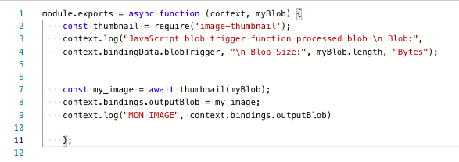

Scripts and container’S ouTPUT

Slide 4
NEXT STEPS
Create my email-function
Make sure that sensitve datas are in .env
Create a GitHub repo
Create readme

